Slide 1

Compositional Reasoning of P programs
P Language
Ankush Desai
Shaz Qadeer

Slide 2
Recap
P program is a collection of state machines.
P provides primitives for modeling non-determinism and performing “unit” testing.
P compiler generates both code for systematic testing and C/C++ code for execution.
P systematic testing engine is able to reproduce hard to find Heisenbugs in asynchronous message passing programs.

Slide 3
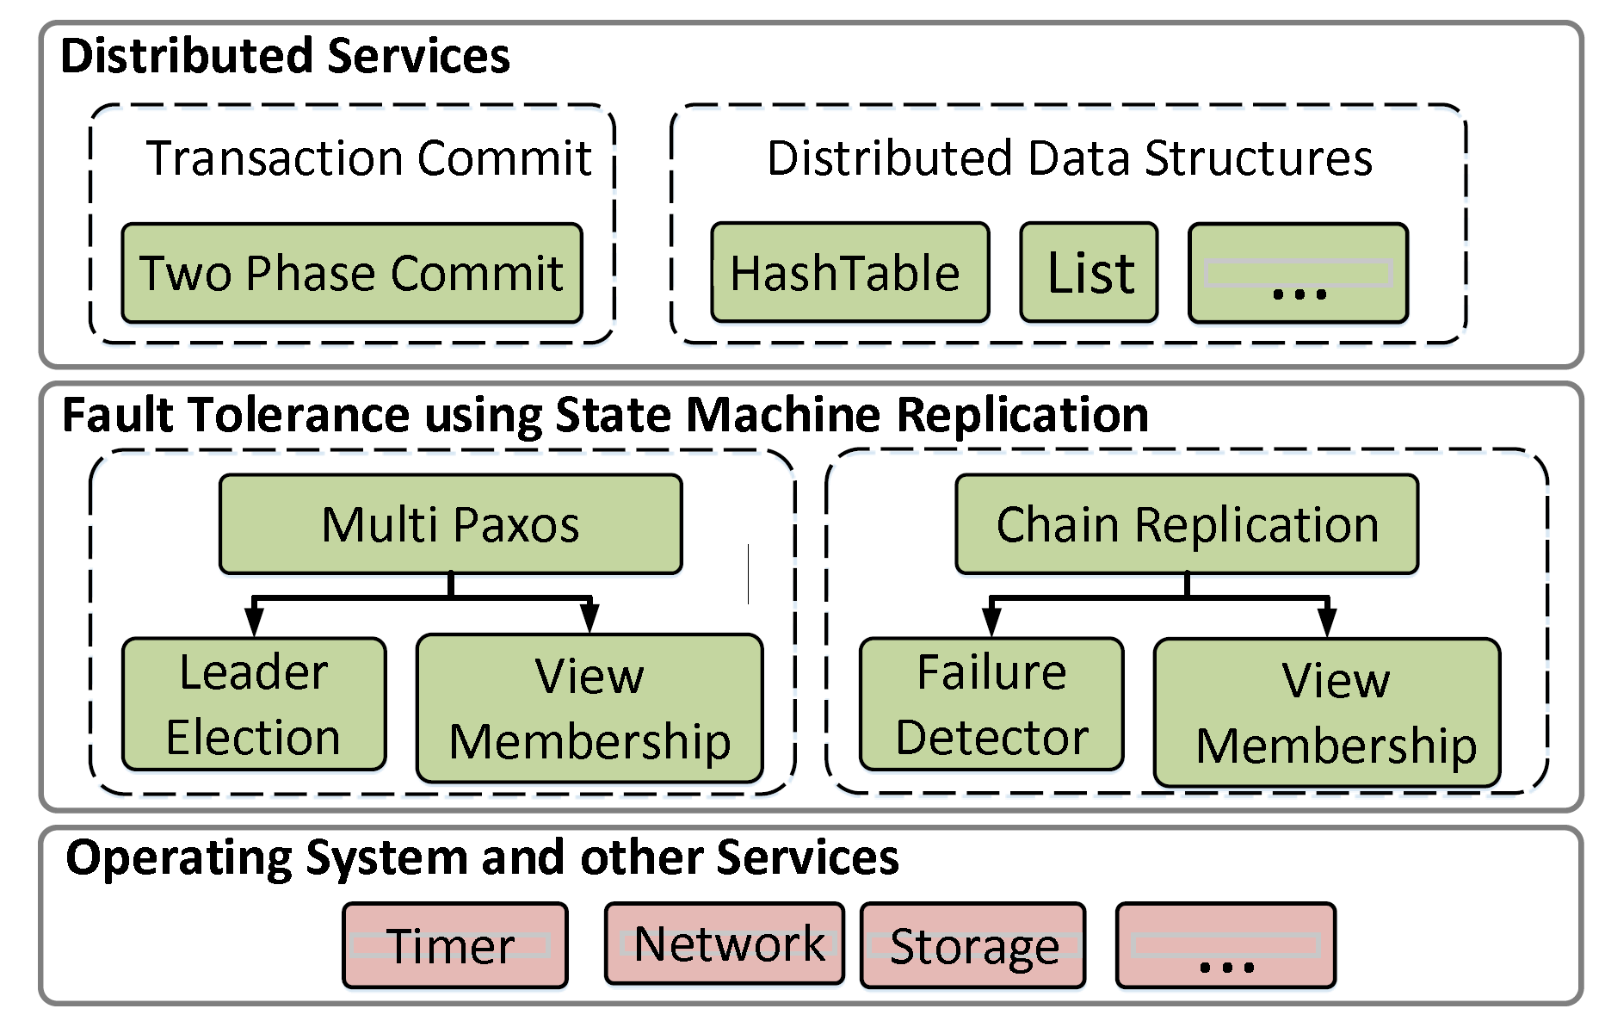
Fault-Tolerant Distributed System
Transaction commit service using Two Phase Commit protocol.
Software stack of a fault-tolerant distributed application
State machine replication is a general method for implementing a fault-tolerant service by replicating logs.

Slide 4
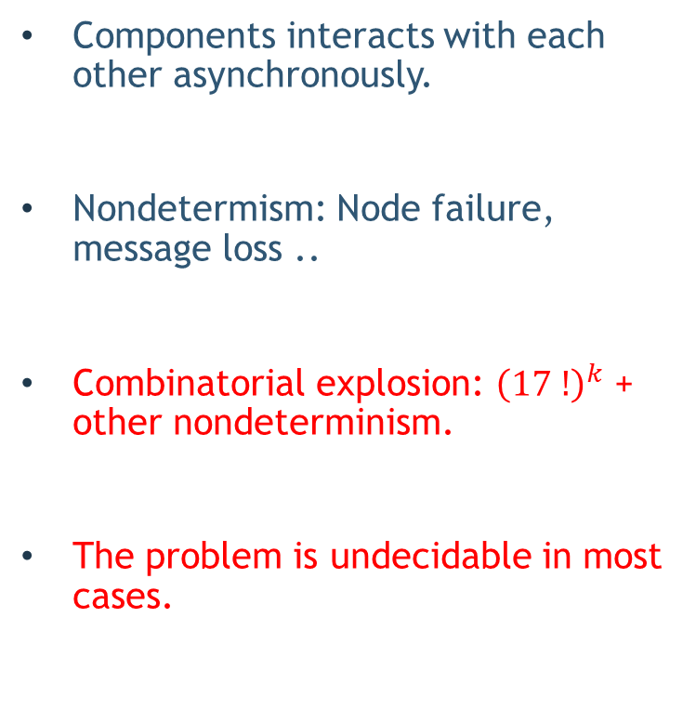
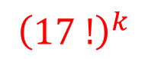
Building Distributed Systems is Challenging
Components interacts with each other asynchronously.
Nondetermism: Node failure, message loss ..
Combinatorial explosion: ${\left(17 !\right)}^{k}$ + other nondeterminism.
The problem is undecidable in most cases.
1 fault tolerant system
4
3
3
3
3
$${\left(17 !\right)}^{k}$$

Slide 5
Exhaustive and random search techniques do not scale.
Inadequate test coverage.
Symbolic execution based approaches also face the path explosion problem.
In practice, bugs are generally found in production or after deployment !

Slide 6
Scalable Testing of Distributed Systems
Problem:
Monolithic testing does not scale.
No re-use of the systematic testing effort.

Slide 7
Solution: Divide and Conquer
Solution:
Test-amplification via abstractions: Test each component in isolation.
Module system based on theory compositional refinement: Test “whole-system” properties from testing of each component in isolation.

Slide 8
Assume Guarantee (AG) Reasoning
The unit of compositional reasoning in ModP is an open module.

Slide 9
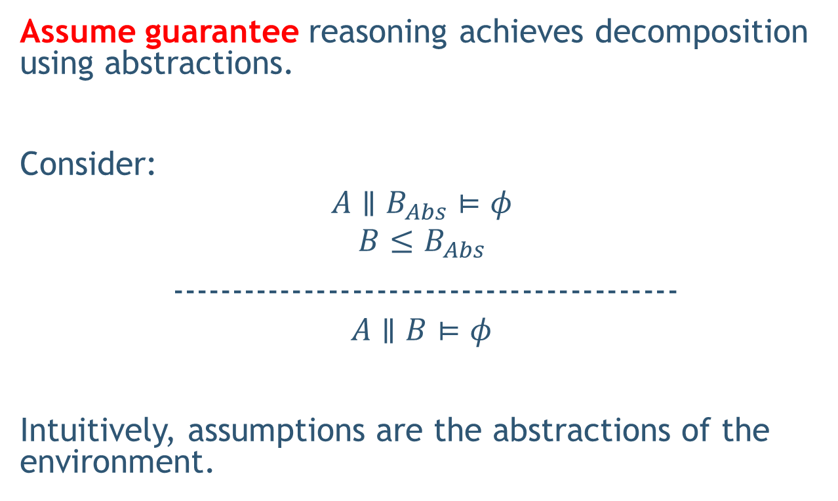
Test Amplification via Abstraction
Assume guarantee reasoning achieves decomposition using abstractions.
Consider:
$$A∥B_{Abs}⊨φ$$
$$B≤B_{Abs}$$
------------------------------------------
$$A∥B⊨φ$$
Intuitively, assumptions are the abstractions of the environment.

Slide 10
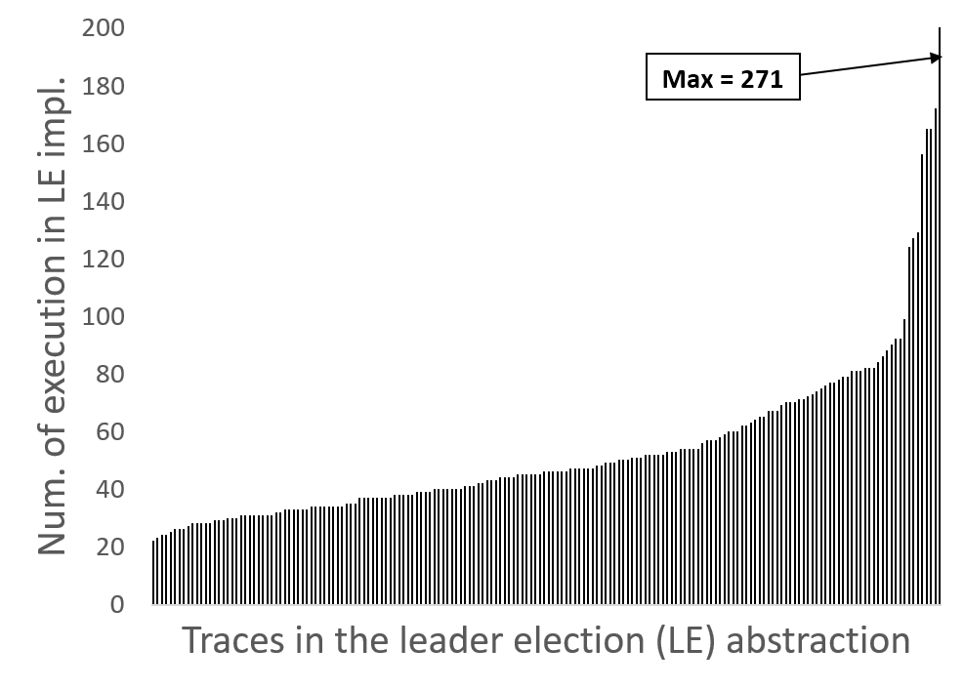
Test-Coverage Amplification
$$MultiPaxos∥ LeaderElection≤Linearizability$$
$$MultiPaxos∥ LeaderElectionAbs≤Linearizability$$
N = 3, K = 50

Slide 11
Compositional Reasoning of Distributed Systems
Decompose using AG principle into following simpler checks:

Slide 12
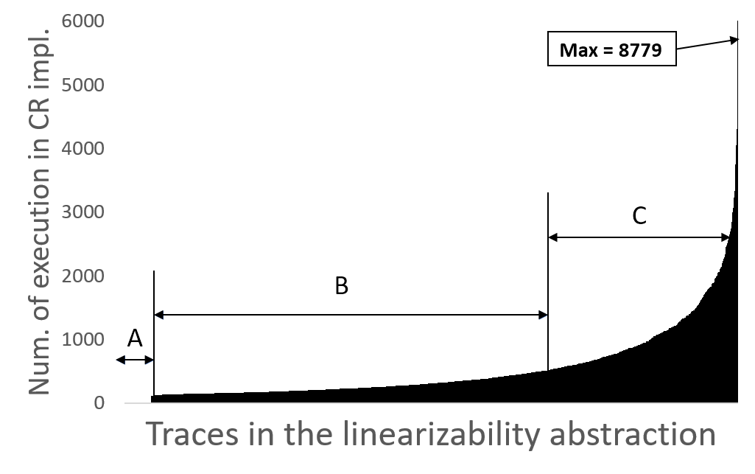
Test-Coverage Amplification

Slide 13
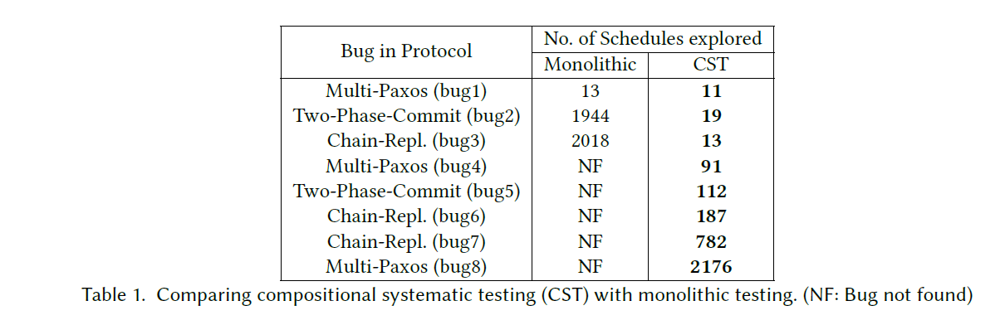
Compositional vs Monolithic

Slide 14
Module
A module in P is a collection of state machines.
module System = { ClientMachine, ServerMachine };

Slide 15
Substitution
A key feature required for compositional reasoning is substitution, the ability to seamlessly bind the creation statement:
new DatabaseServer()
to DatabaseServerImpl() when testing server implementation and to DatabaseServerAbs() when testing its environment.

Slide 16
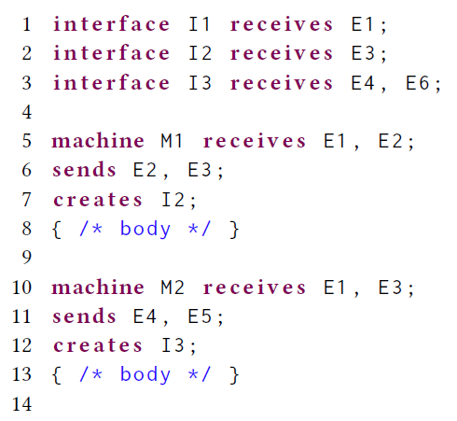
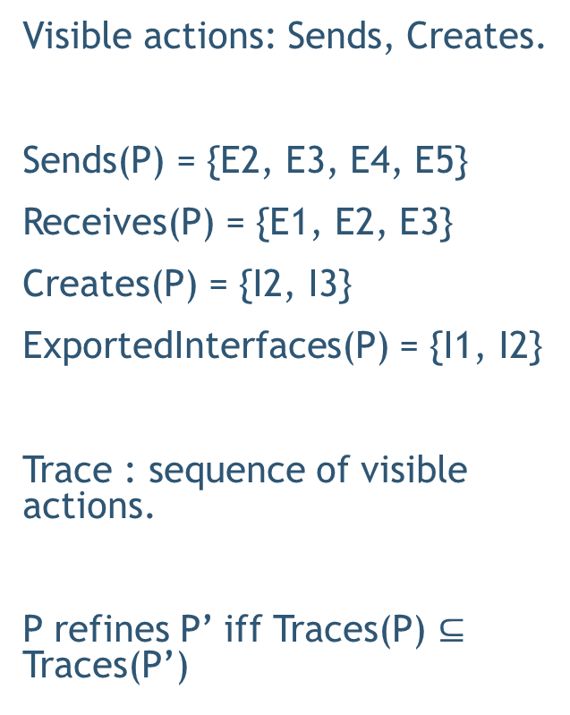
Traces and Refinement
Visible actions: Sends, Creates.
Sends(P) = {E2, E3, E4, E5}
Receives(P) = {E1, E2, E3}
Creates(P) = {I2, I3}
ExportedInterfaces(P) = {I1, I2}
Trace : sequence of visible actions.
P refines P’ iff Traces(P) $⊆$ Traces(P’)

Slide 17
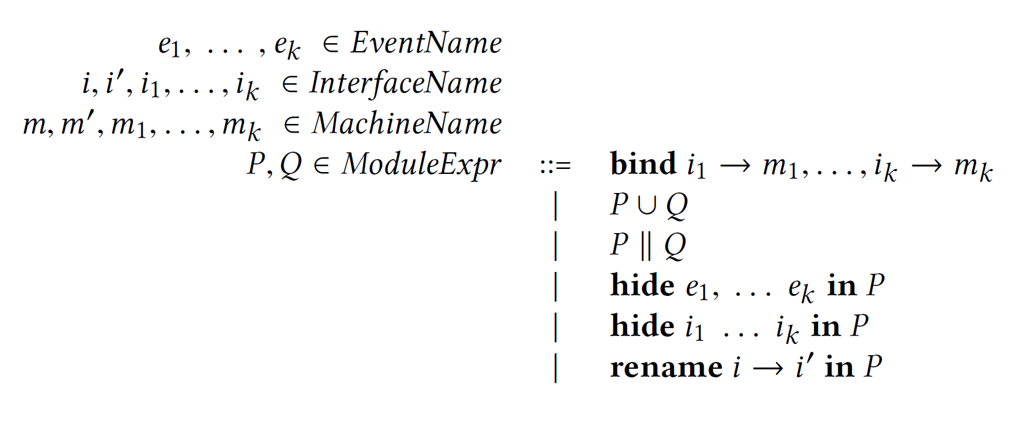
Module Contructors

Slide 18
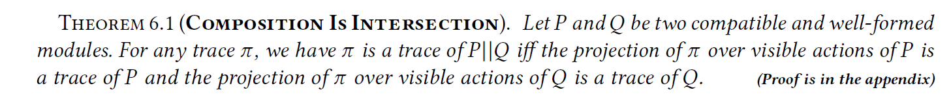
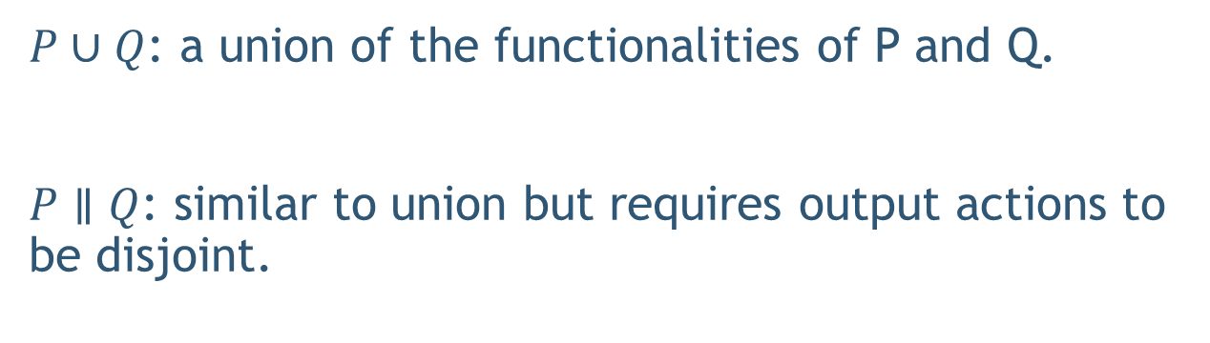
Union and Composition
$P∪Q$: a union of the functionalities of P and Q.
$P∥Q$: similar to union but requires output actions to be disjoint.

Slide 19
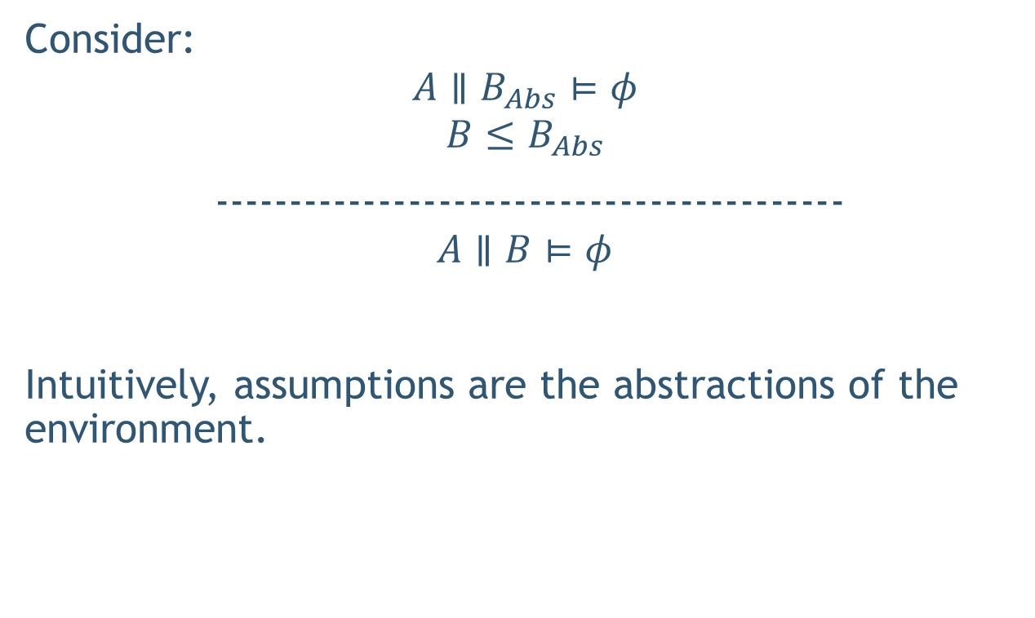
Assume Guarantee (AG) Reasoning
Consider:
$$A∥B_{Abs}⊨φ$$
$$B≤B_{Abs}$$
------------------------------------------
$$A∥B⊨φ$$
Intuitively, assumptions are the abstractions of the environment.

Slide 20
Example
Compositional Reasoning and Refinement Checking

Slide 21
Hierarchical Reasoning
https://github.com/p-org/P/blob/master/Src/Samples/FaultTolerantDistributedSystems/ChainReplication/Test/TestScript.p

Slide 22
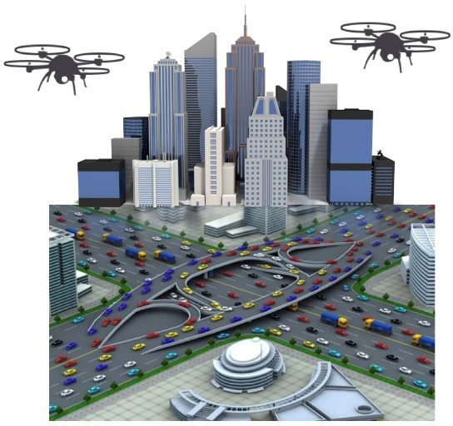
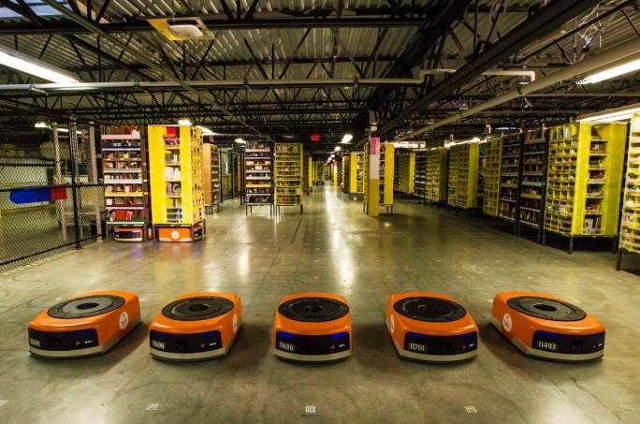
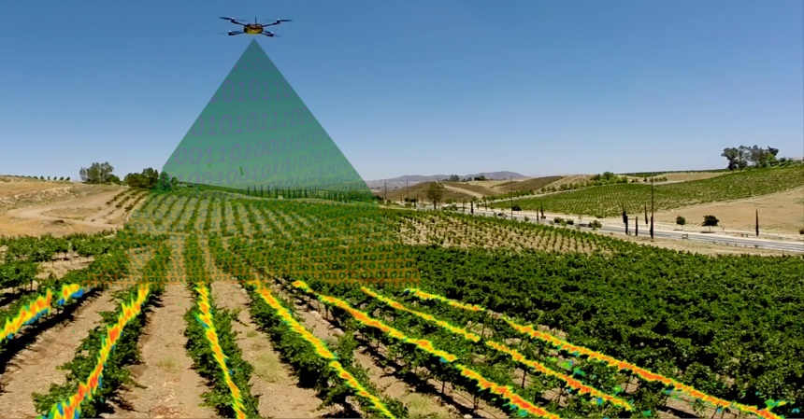
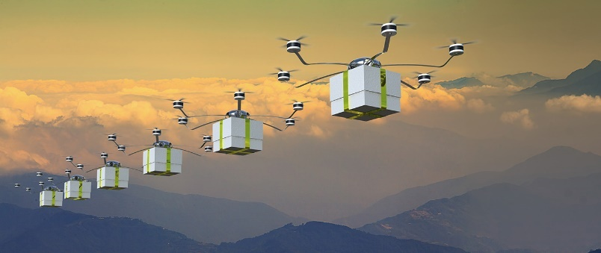
Autonomous Mobile Robotics
Warehouse
A major challenge in autonomous mobile robotics is programming robots with formal guarantees and high assurance of correct operation.
Surveillance
Delivery Systems
Agriculture
Notes:
Recent advances in autonomous robots collaborating to accomplish complex missions have been brought back exciting times for robotics research.
They have been applied to build real world systems and found applications in areas like

Slide 23
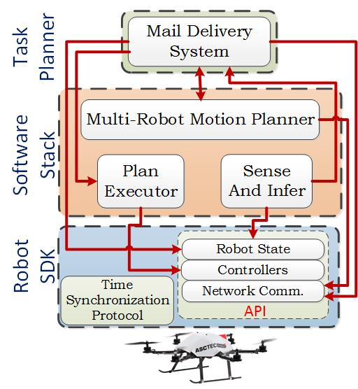
Robotic Software

Slide 24
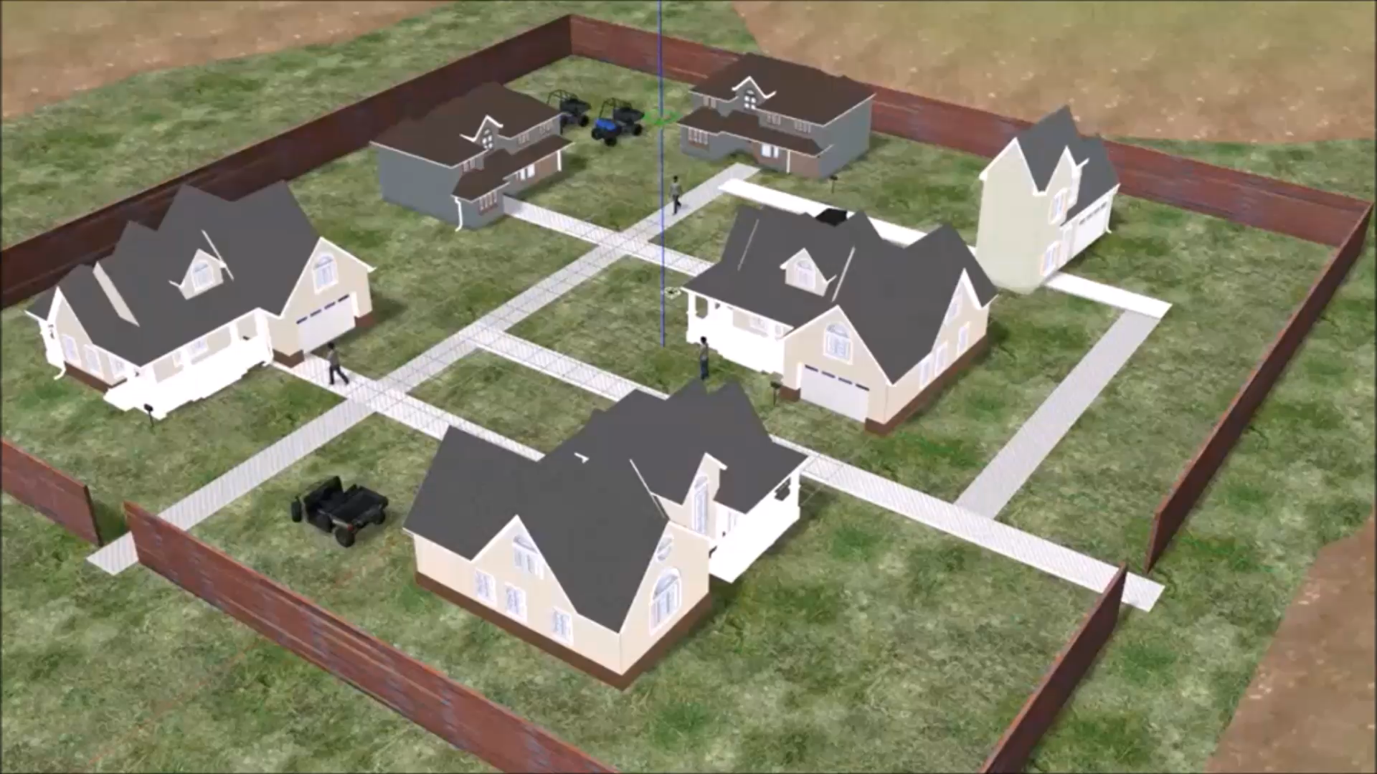
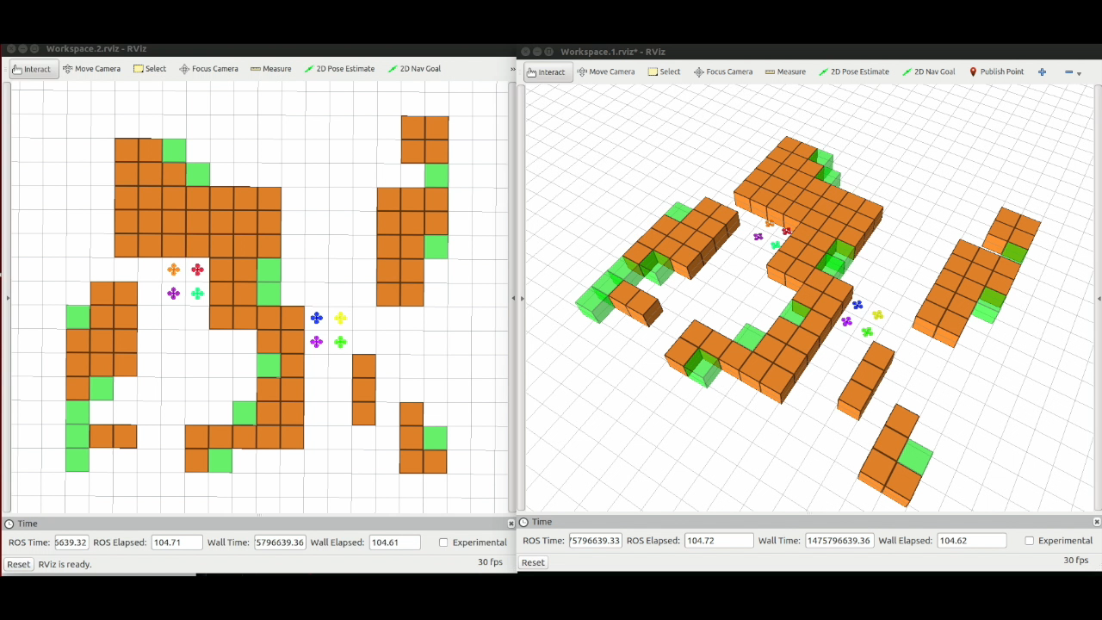
Demo Video

Slide 25
Thank You
DRONA is available on GitHub.
http://drona-org.github.io/Drona/

